Slide 1
QlikSense Training
I&D India – QlikSense CoE

Slide 2
Session 04

Slide 3
Session Agenda
Using Search Tools Sorting Items in Visualizations
Build and Play Stories
Overview of QMC
Understanding Extensions
Introduction to Widgets

Slide 4
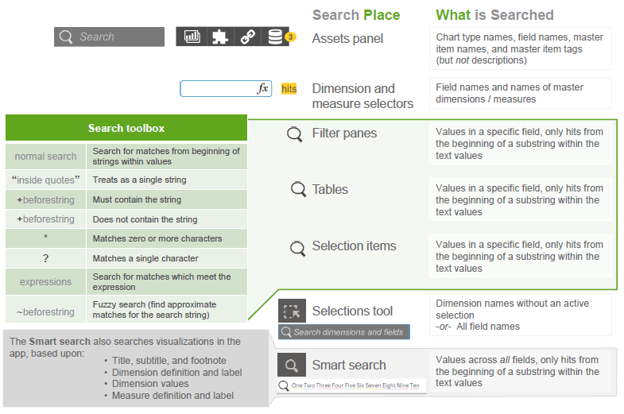
Using Search Tools Sorting Items in Visualizations

Slide 5
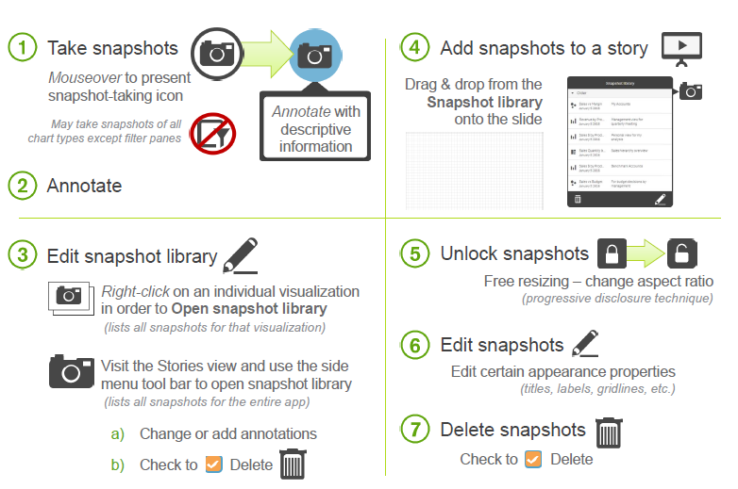
Build and Play Stories
Select the visualization and take a Snap
Snap will be saved in Snap library

Slide 6
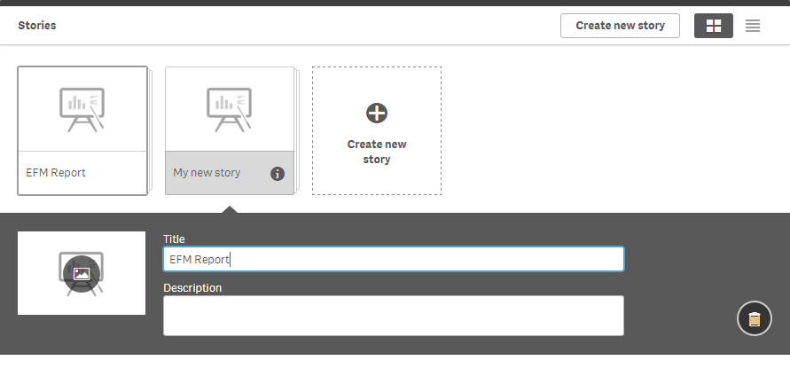
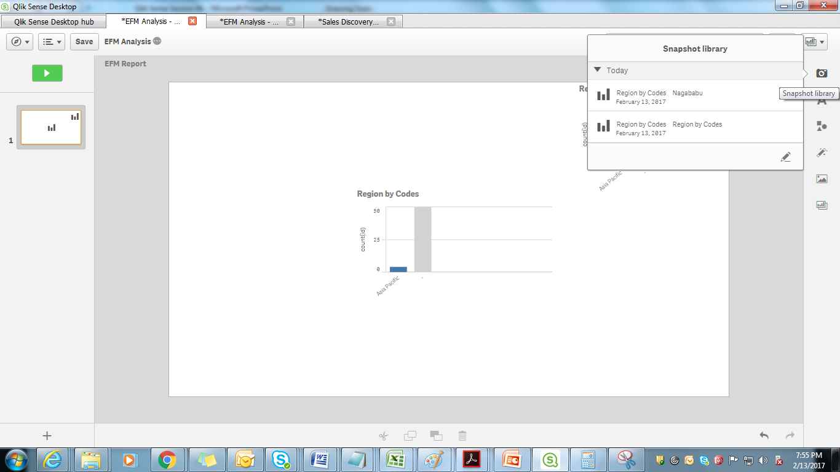
Build and Play Stories
Add the Story sheet Name
Take the selected visualizations from Snapshot library
Drag it into PPT
Add the textual information if Required

Slide 7
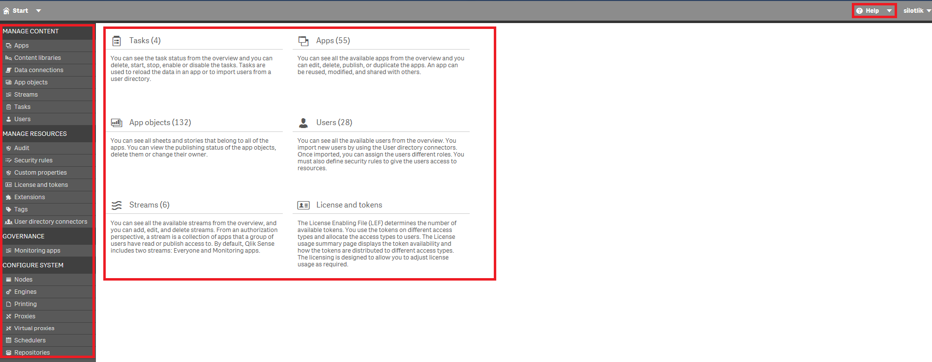
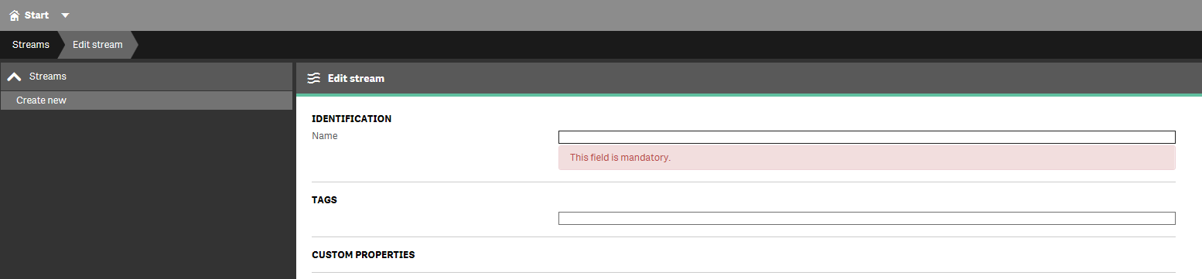
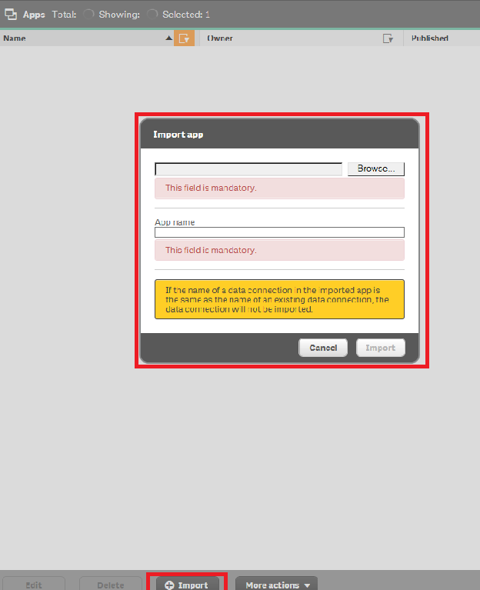
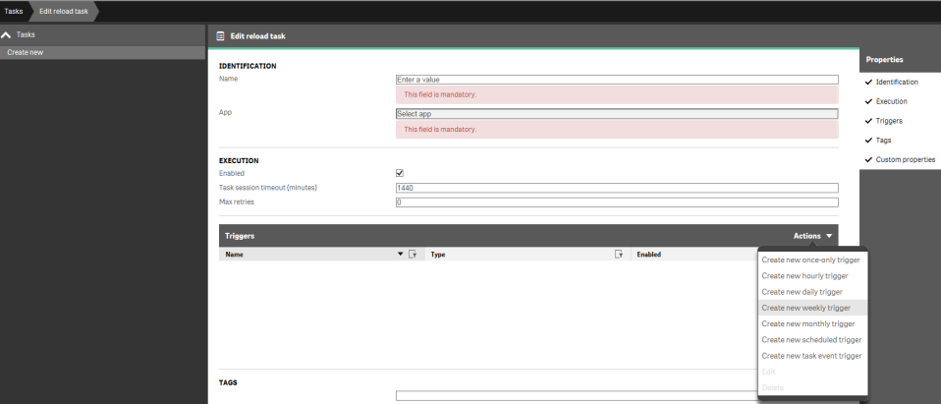
QMC
QMC Navigation:
Create streams :
Importing app :
Create and schedule tasks :

Slide 8
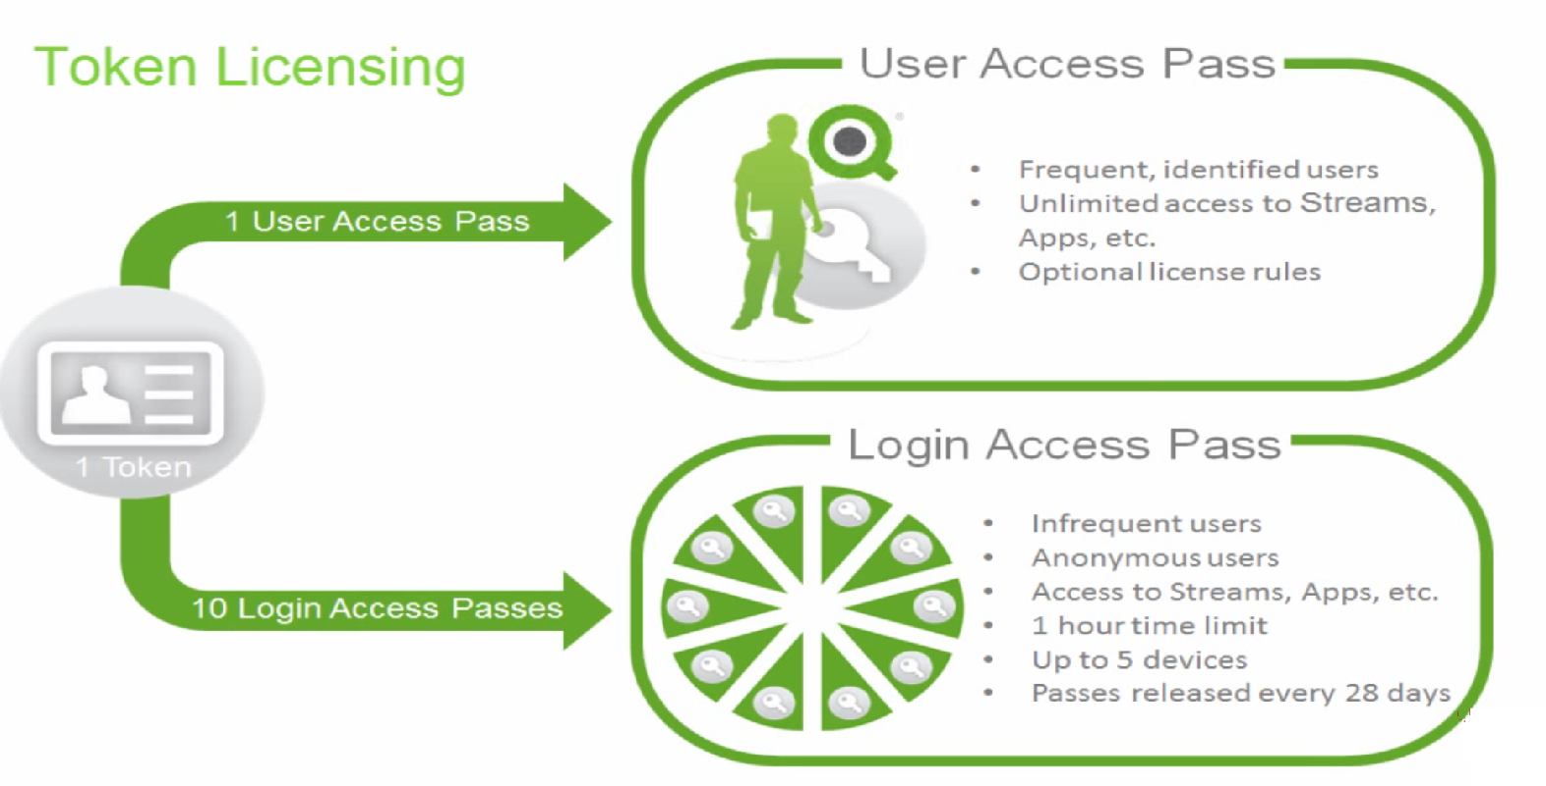
QMC

Slide 9
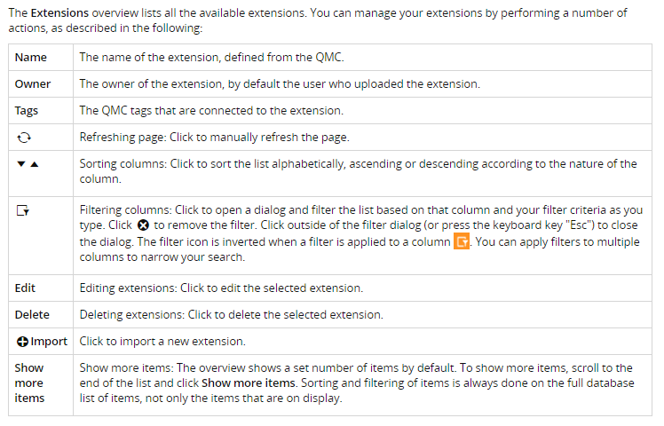
Understanding Extensions
Extensions :
Extensions can be used to visualize data, for example, in an interactive map where you can select different regions.
The Extensions overview lists all the available extensions. The following table presents the available fields and buttons. By default, only some of the fields are displayed. You can use the column selector (') to add fields.

Slide 10
Understanding Extensions
Importing extensions:
By default only the RootAdmin user has the access rights to import extensions. To enable others to import extensions, you need to define security rules for this. Also, by default all Qlik Sense users have access to all extensions that you add. To change this you need to revise the security rule named Extension.
You can add extensions in the following way.
Select Extensions on the QMC start page or from the Start drop-down menu to display the overview.
Click + Import in the action bar.
The Import extension file dialog opens. Select a zip file to import.
Remember to enter the password for the zip file if it is password protected.
Click Open in the file explorer window.
Click Import.

Slide 11
Introduction to Widgets
Widgets:
Widgets are used to customize the behavior and appearance of your sheets and visualizations.
Widgets are simple app objects created using only HTML and CSS/LESS.
You create and edit widgets in the Widget editor and store them in widget libraries, which are then available from the assets panel in your apps. Qlik Sense has a default widget library that contains a set of widgets that are ready to use with little or no customization.
Widgets are best suited for creating simple visualizations, such as KPI objects and tables. Widgets can also be used to add simple functionality to sheets, such as buttons to clear selections or take snapshots, or to add other visual elements.
Below are the steps to create Widgets
Added to a sheet using drag and drop.
Configured to use the same property panel as standard Qlik Sense visualizations, meaning that you can create widgets on top of the data of a Qlik Sense app.
Resized, copied, pasted, and positioned just like any other Qlik Sense visualization.
Added to and used in data storytelling.
Responsive and, therefore, work properly on any device.

Slide 12
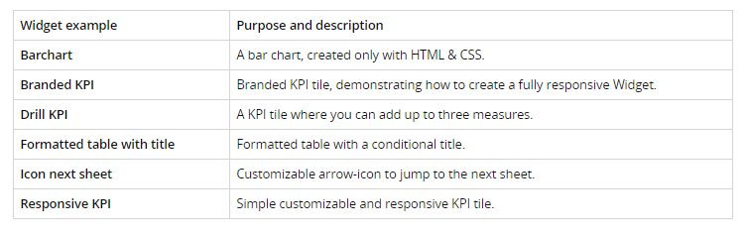
Widgets Examples
Widget examples
The following widgets are included in the widget-examples library that comes with the Qlik Sense installation.

Slide 13
QlikView Training – Session 04
Thank You

